Slide 1
Zylinc Cloud 2.3.1

Slide 2
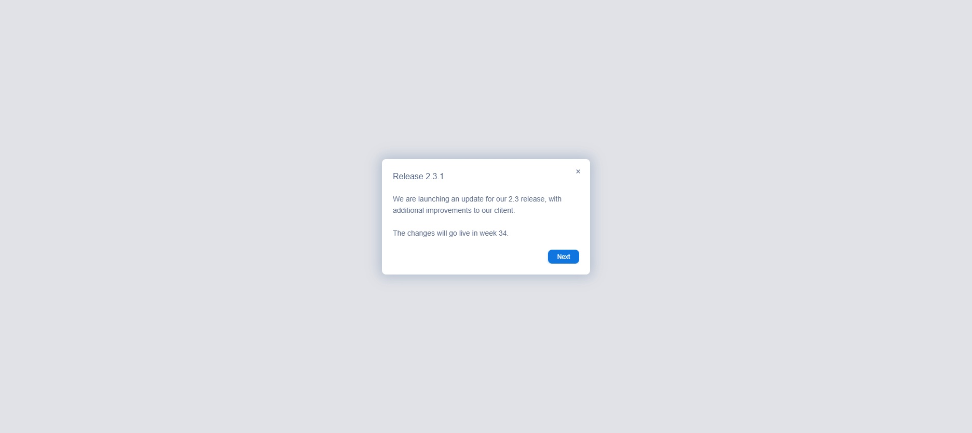
Release 2.3.1
Notes:
Step#: 1
Step Type: Balloon
Create Date: Fri Jul 15 2022
Created By: hsk@zylinc.com
Captured URL:

Slide 3
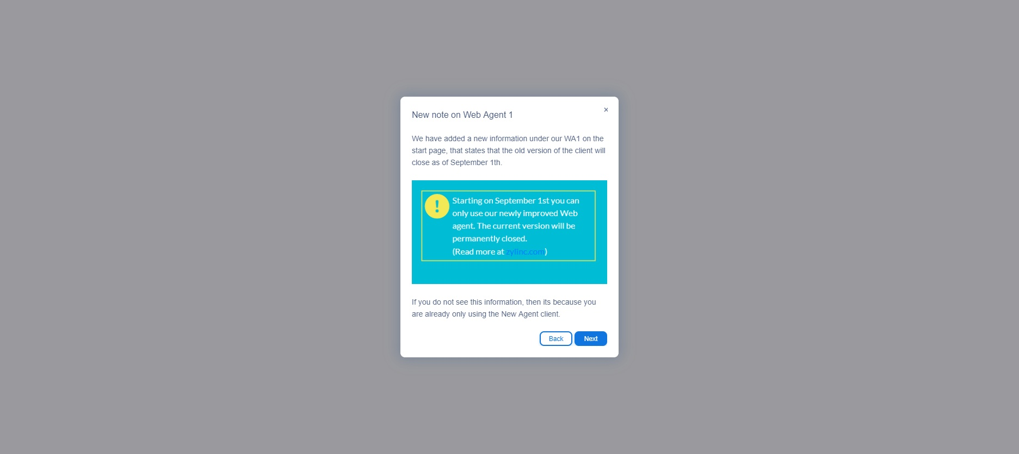
New note on Web Agent 1
Notes:
Step#: 2
Step Type: Balloon
Create Date: Fri Aug 19 2022
Created By: hsk@zylinc.com
Captured URL:

Slide 4
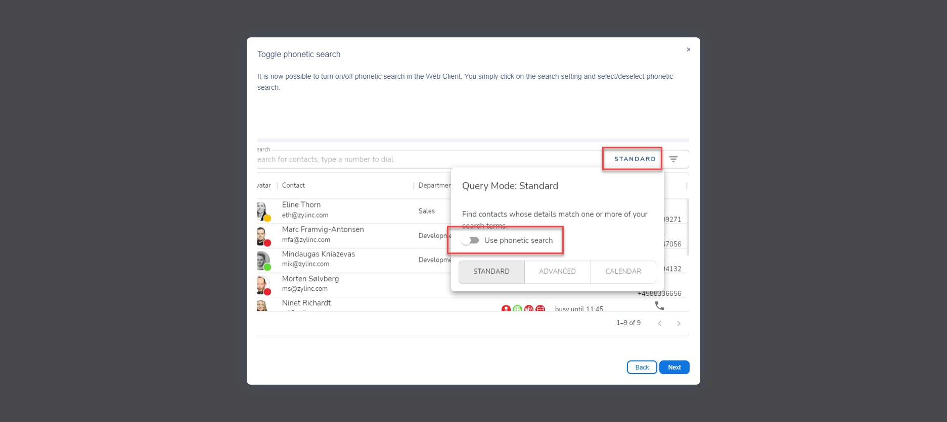
Toggle phonetic search
Notes:
Step#: 3
Step Type: Balloon
Create Date: Fri Jul 15 2022
Created By: hsk@zylinc.com
Captured URL:

Slide 5
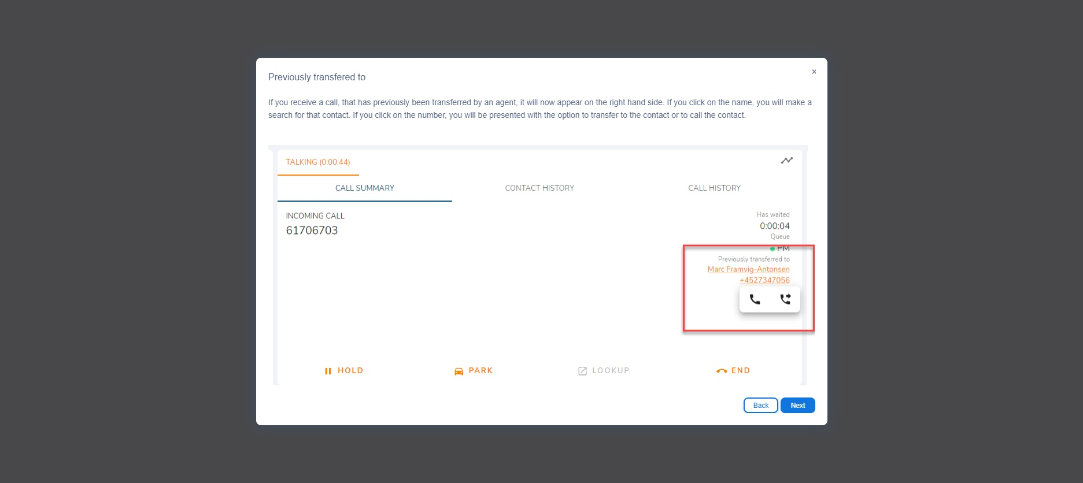
Previously transfered to
Notes:
Step#: 4
Step Type: Balloon
Create Date: Fri Jul 15 2022
Created By: hsk@zylinc.com
Captured URL:

Slide 6
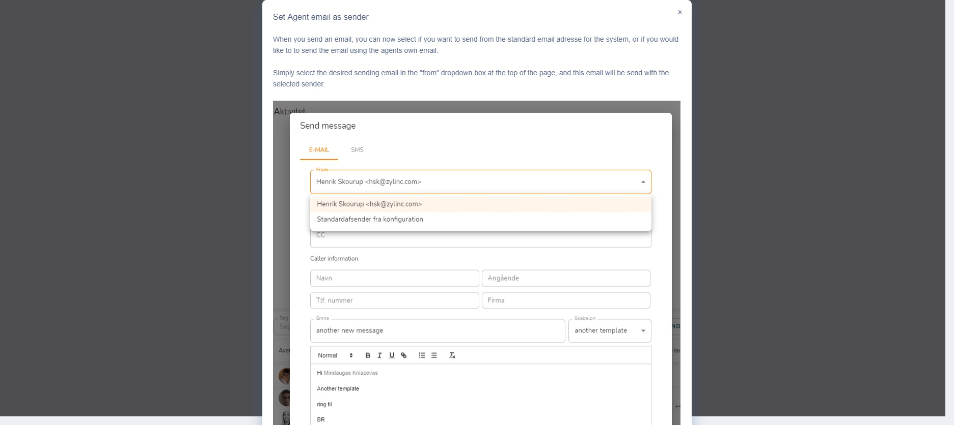
Set Agent email as sender
Notes:
Step#: 5
Step Type: Balloon
Create Date: Thu Aug 11 2022
Created By: hsk@zylinc.com
Captured URL:

Slide 7
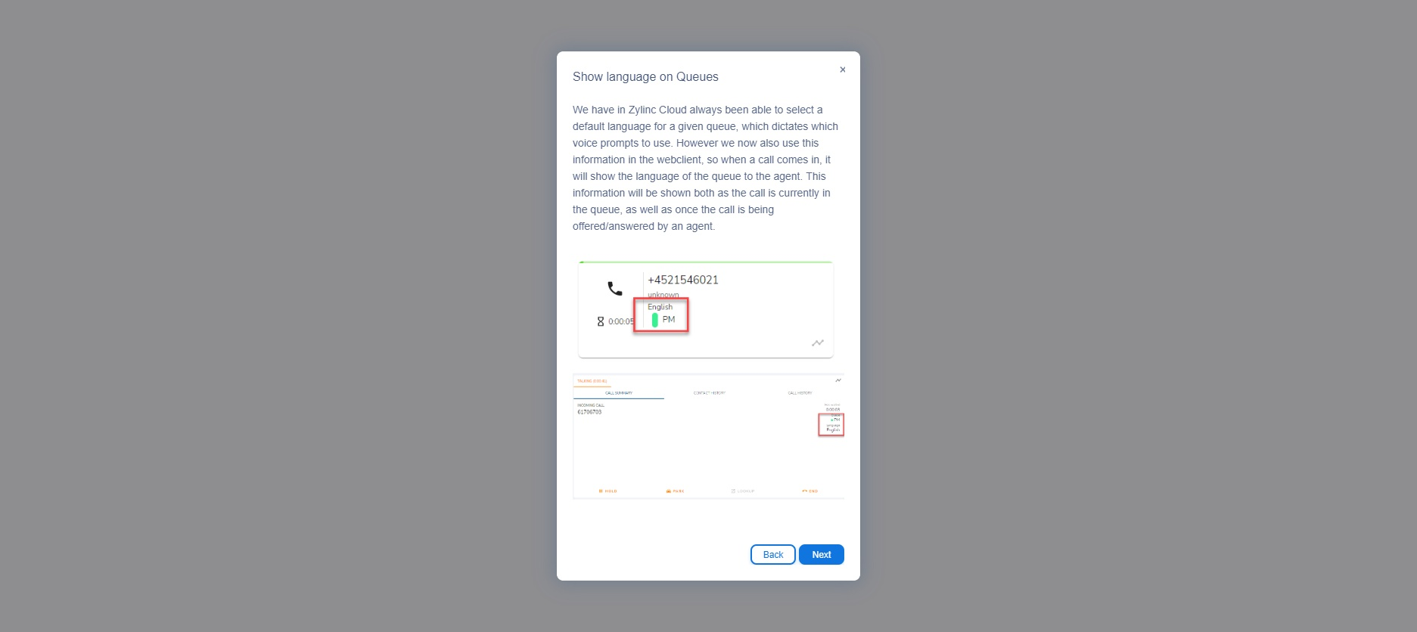
Show language on Queues
Notes:
Step#: 6
Step Type: Balloon
Create Date: Fri Aug 19 2022
Created By: hsk@zylinc.com
Captured URL:

Slide 8
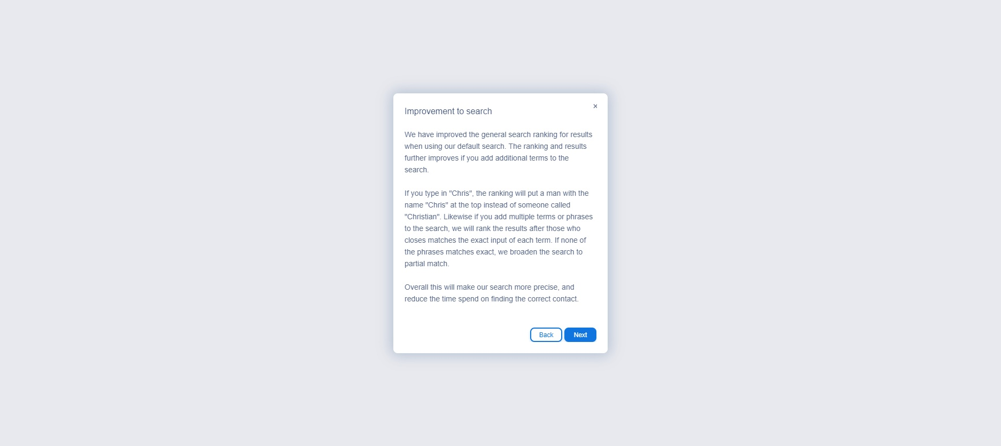
Improvement to search
Notes:
Step#: 7
Step Type: Balloon
Create Date: Thu Aug 11 2022
Created By: hsk@zylinc.com
Captured URL:

Slide 9
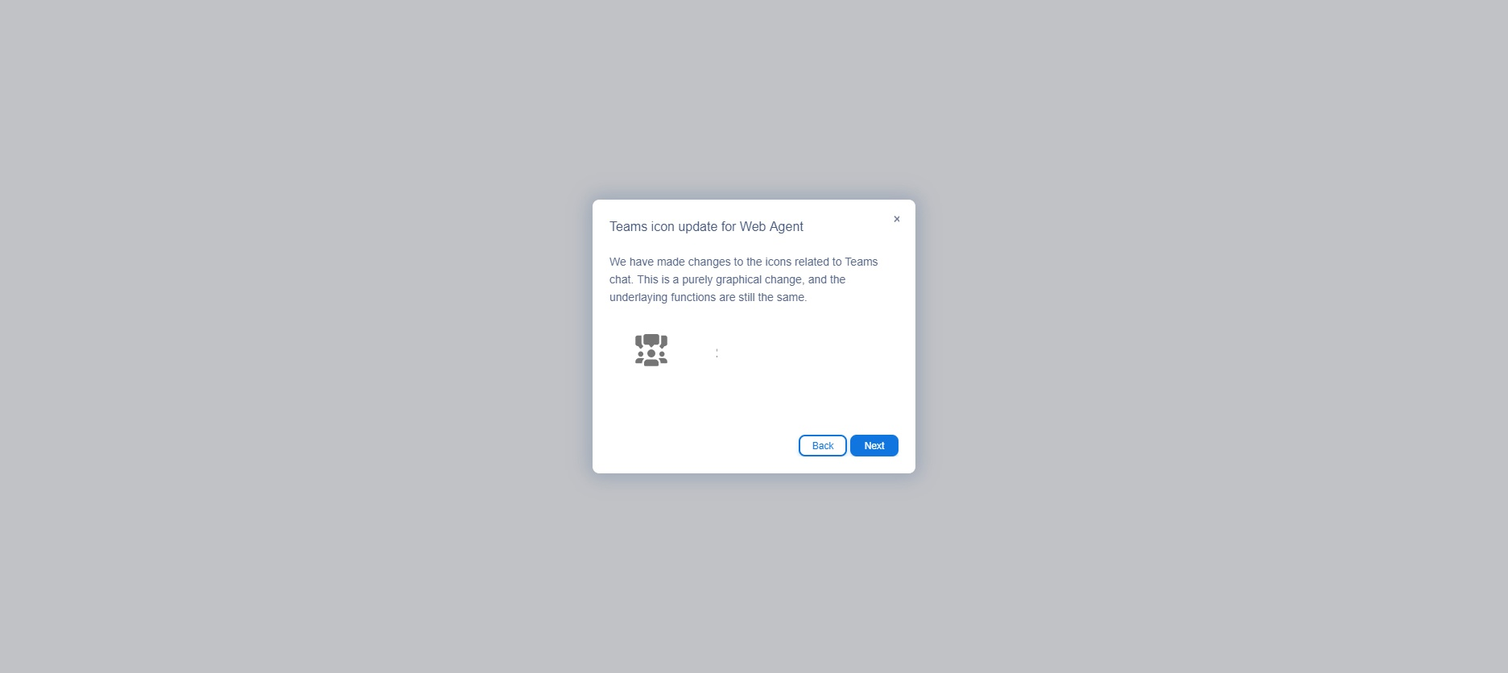
Teams icon update for Web Agent
Notes:
Step#: 8
Step Type: Balloon
Create Date: Fri Aug 19 2022
Created By: hsk@zylinc.com
Captured URL:

Slide 10
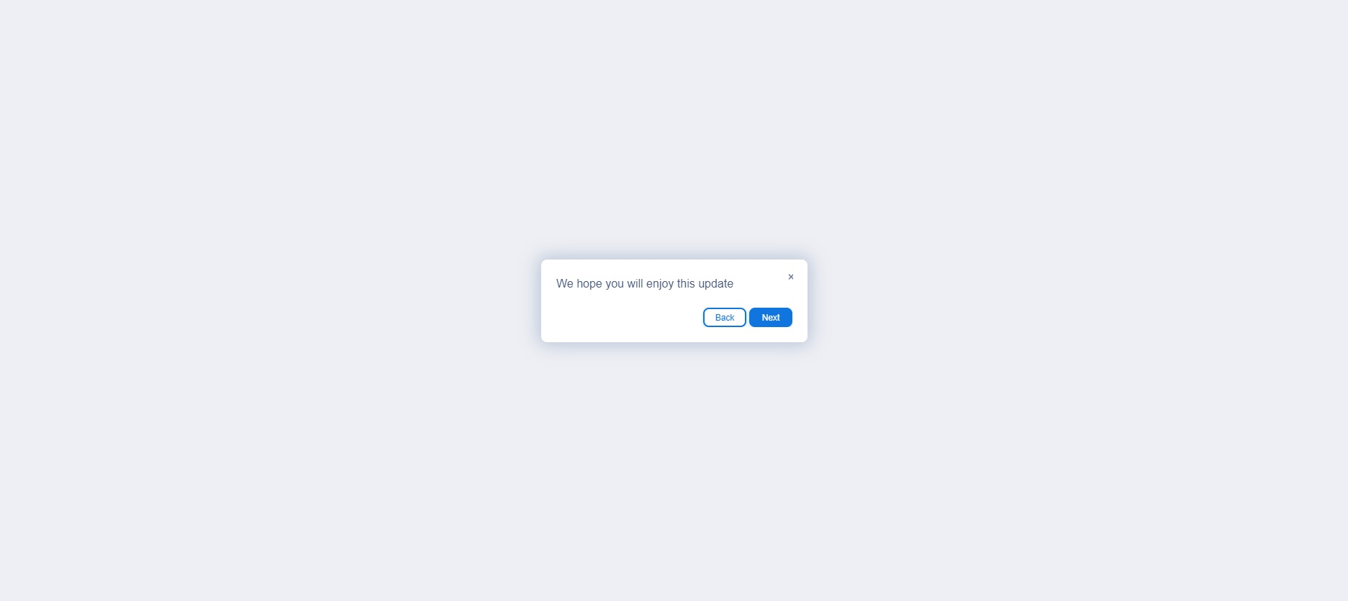
We hope you will enjoy this update
Notes:
Step#: 9
Step Type: Balloon
Create Date: Fri Jul 15 2022
Created By: hsk@zylinc.com
Captured URL:

